Slide 1
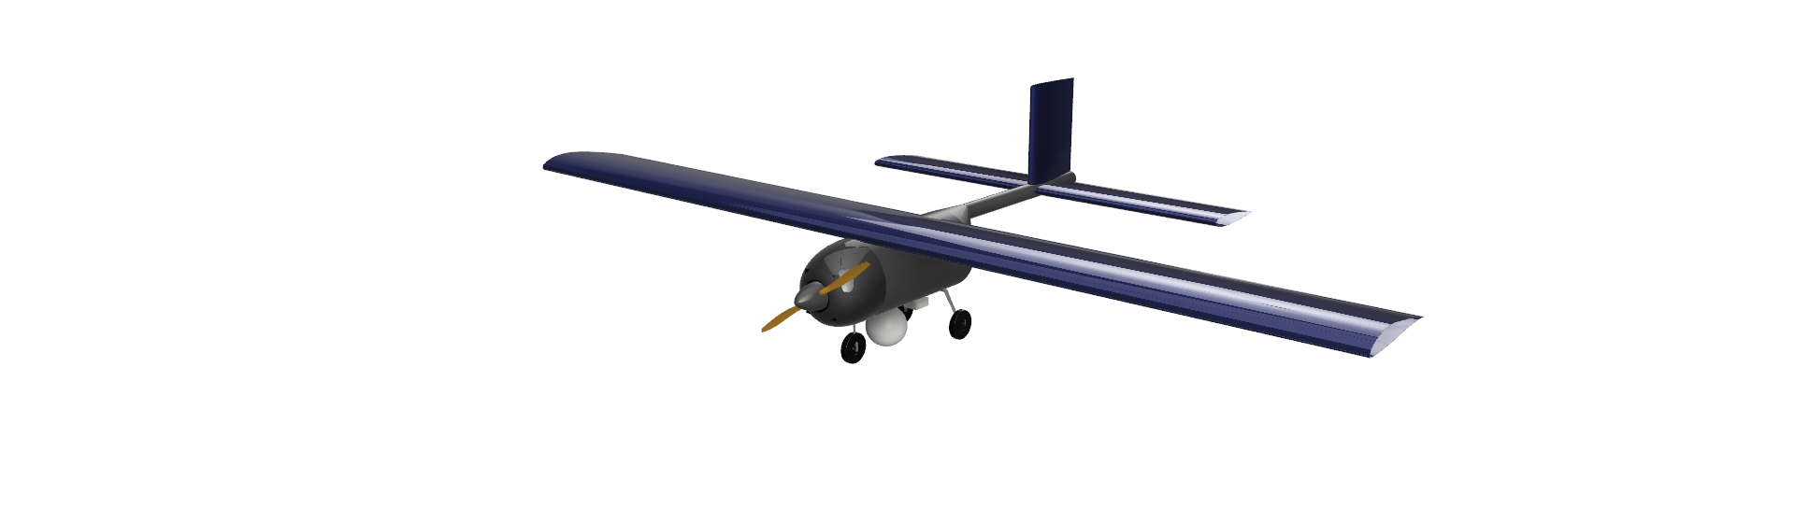
DESIGN OF UAV
Group 5
AE21B002 : Abhigyan Roy
AE23M004 : Vinu Mathew
AE23M008 : Anish Konar
AE23M014 : Gautham Anil
AE23M006 : Aditya Sai Deepak Rachagiri

Slide 2
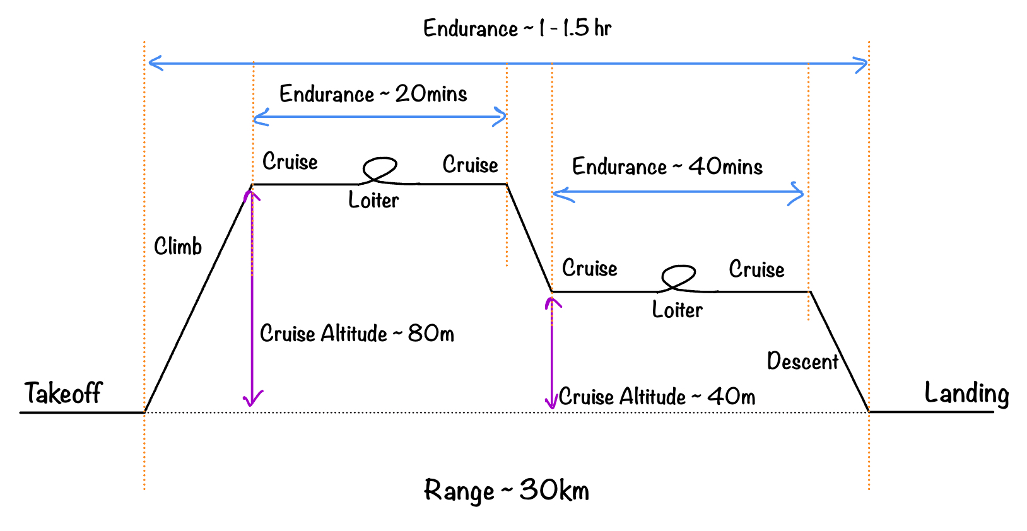
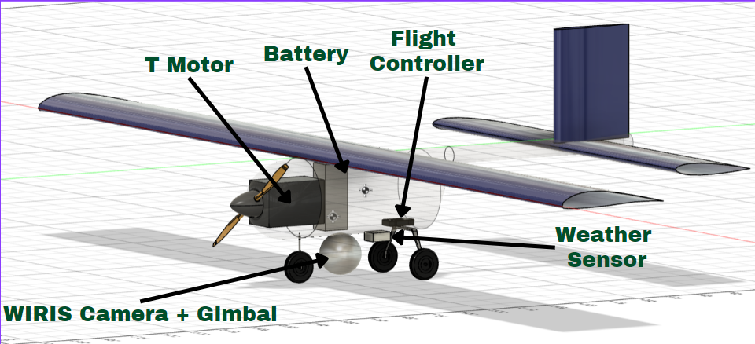
Mission Statement
Monitoring of Flora and Fauna and the environment of forests in the Chennai AOR and Mapping of Forest Cover, including security-based Surveillance of the forest within the said Area of Responsibility.
Component | Weight (N) | Position from Nose (mm)
Motor | 8.98 | 53
Propellor | 5.46 | 53
Battery | 22.27 | 186
Wiris Camera | 4.21 | 276
Gimbal | 4.56 | 276
Environmental Sensor | 2.23 | 476
Avionics | 1.96 | 481
Empty Weight | 29.43 | 326
Nose Landing Gear | 0.77 | 150
Main Landing Gear | 1.55 | 350
Horizontal Tail Area | 0.42 m²
Horizontal Tail Span | 1.5 m
Horizontal Tail Aerofoil | NACA 0014
Vertical Tail Area | 0.14 m²
Vertical Tail Span | 0.4 m
Vertical Tail Aerofoil | NACA 0014
MTOW | 8.80 Kg
Wing Area | 0.96 m²
Wing Span | 2.80 m
Wing Chord | 0.34 m
Wing Aerofoil | GOE 553

Slide 3
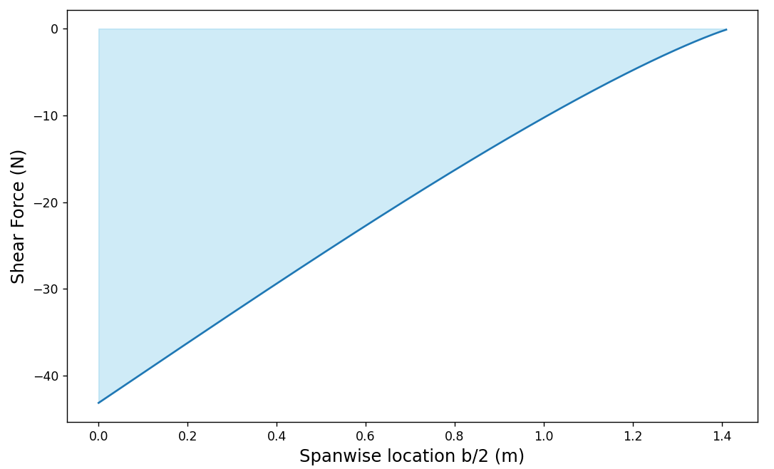
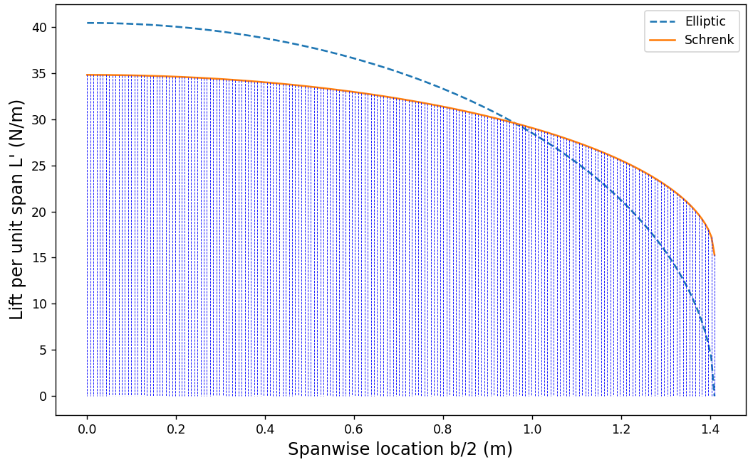
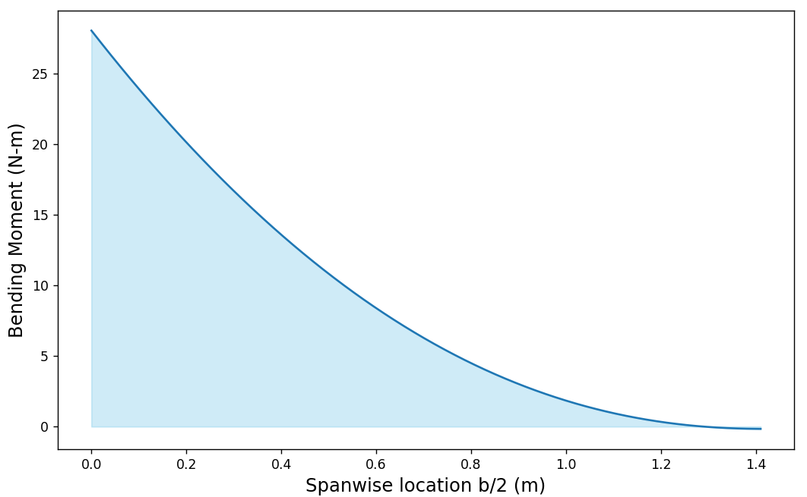
Wing Lift and SFBM Calculations
[Schrenk’s Method]
Wing Span (b) = 2.82 m
Chord (c) = 0.34 m
Area (S) = 0.90 m²
Half Span (b) = 1.4 m
Reaction Force R = - 43 N
Reaction Moment M = - 28 Nm

Slide 4
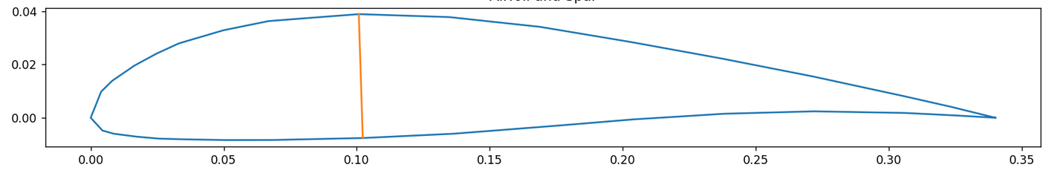
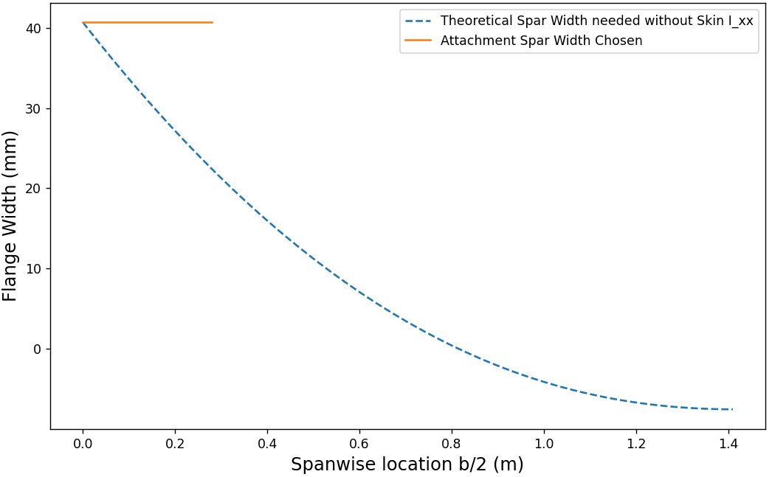
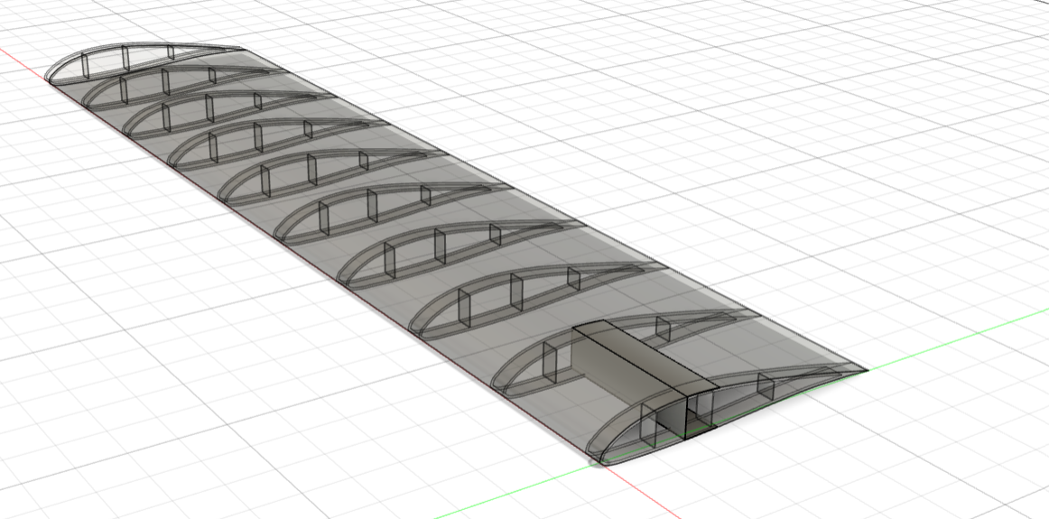
Spar Calculations
Spar (Orange)
Wing Cross Section (Blue)
C Section Spar
Flange Width = 40 mm
Web = 45 mm
Thickness = 0.5 mm
Material : Al
Spar Designed keeping contribution of Skin I_{xx} at 0

Slide 5
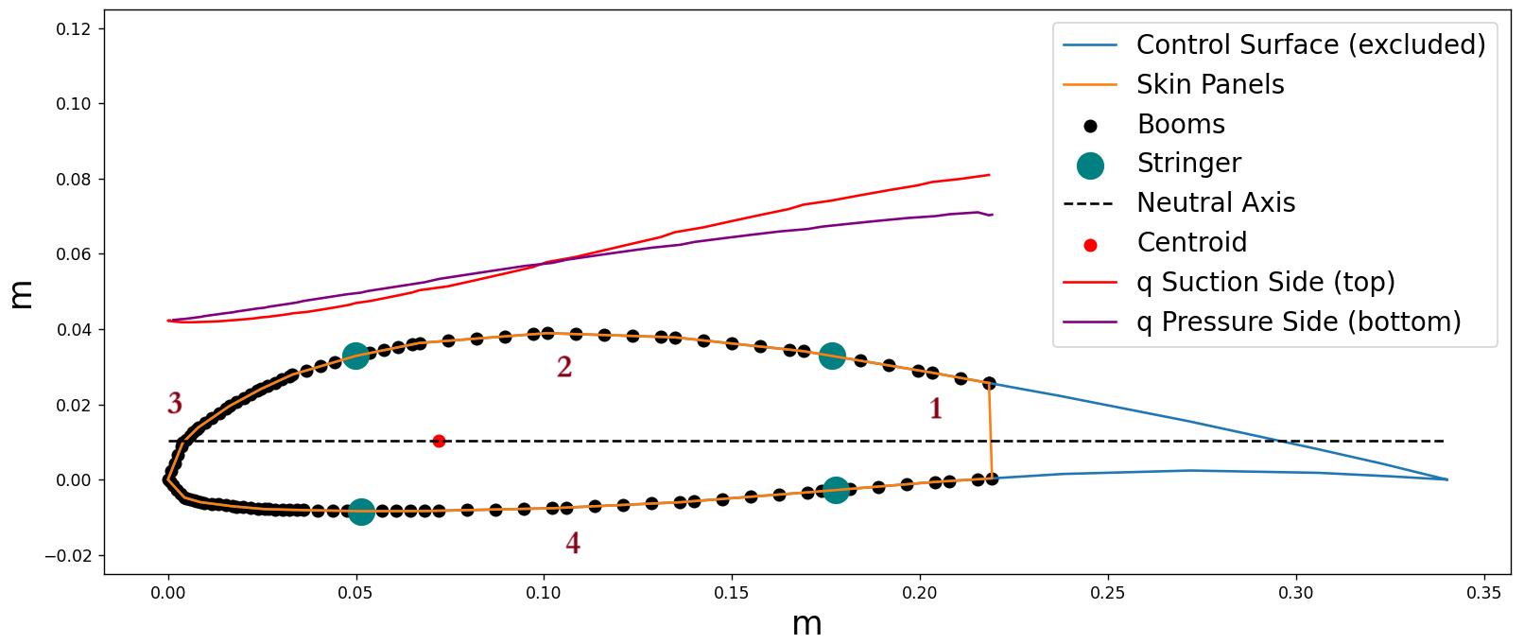
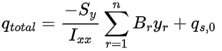
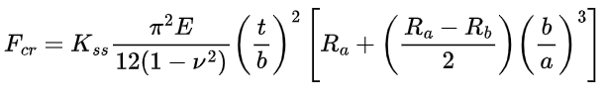
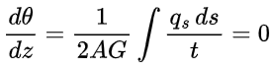
Wing Shear Flow
F_{cr, initial} = 1836
Panel No. | F_{cr} (N/m)
1 | 7760
2 | 4332
3 | 4853
4 | 4332
R_{a} = R_{b} = 1 (Simply Supported)
a = Distance between Rib (0.14 m)
b = Distance between Stringer
ν = Poisson’s Ratio (0.33 for Al)
E = 70 GPa (Aluminium)

Slide 6
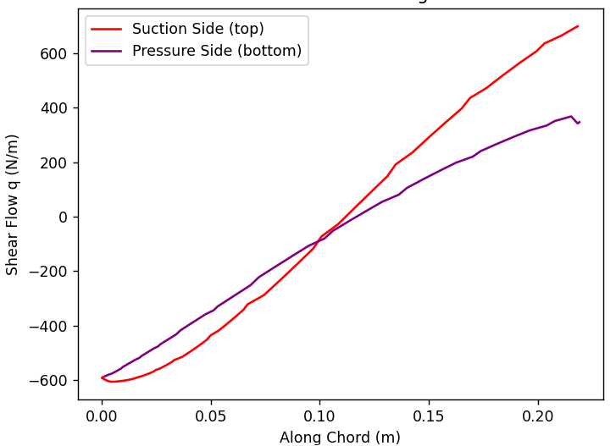
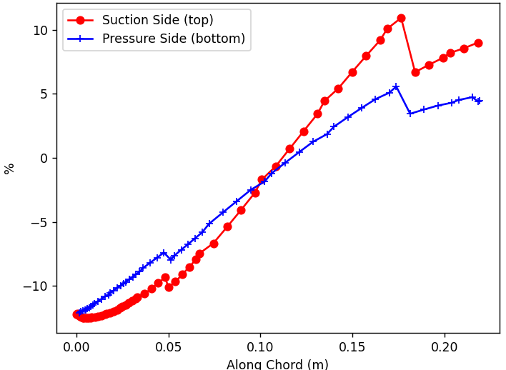
Wing Shear Flow
% of F_{cr} of Shear Flows with Stringers
Total Factor of Safety = 3(n) x 2(FOS) x 1.5(d) = 9
Selected 10 ribs for each half wing
Total : 20 ribs

Slide 7
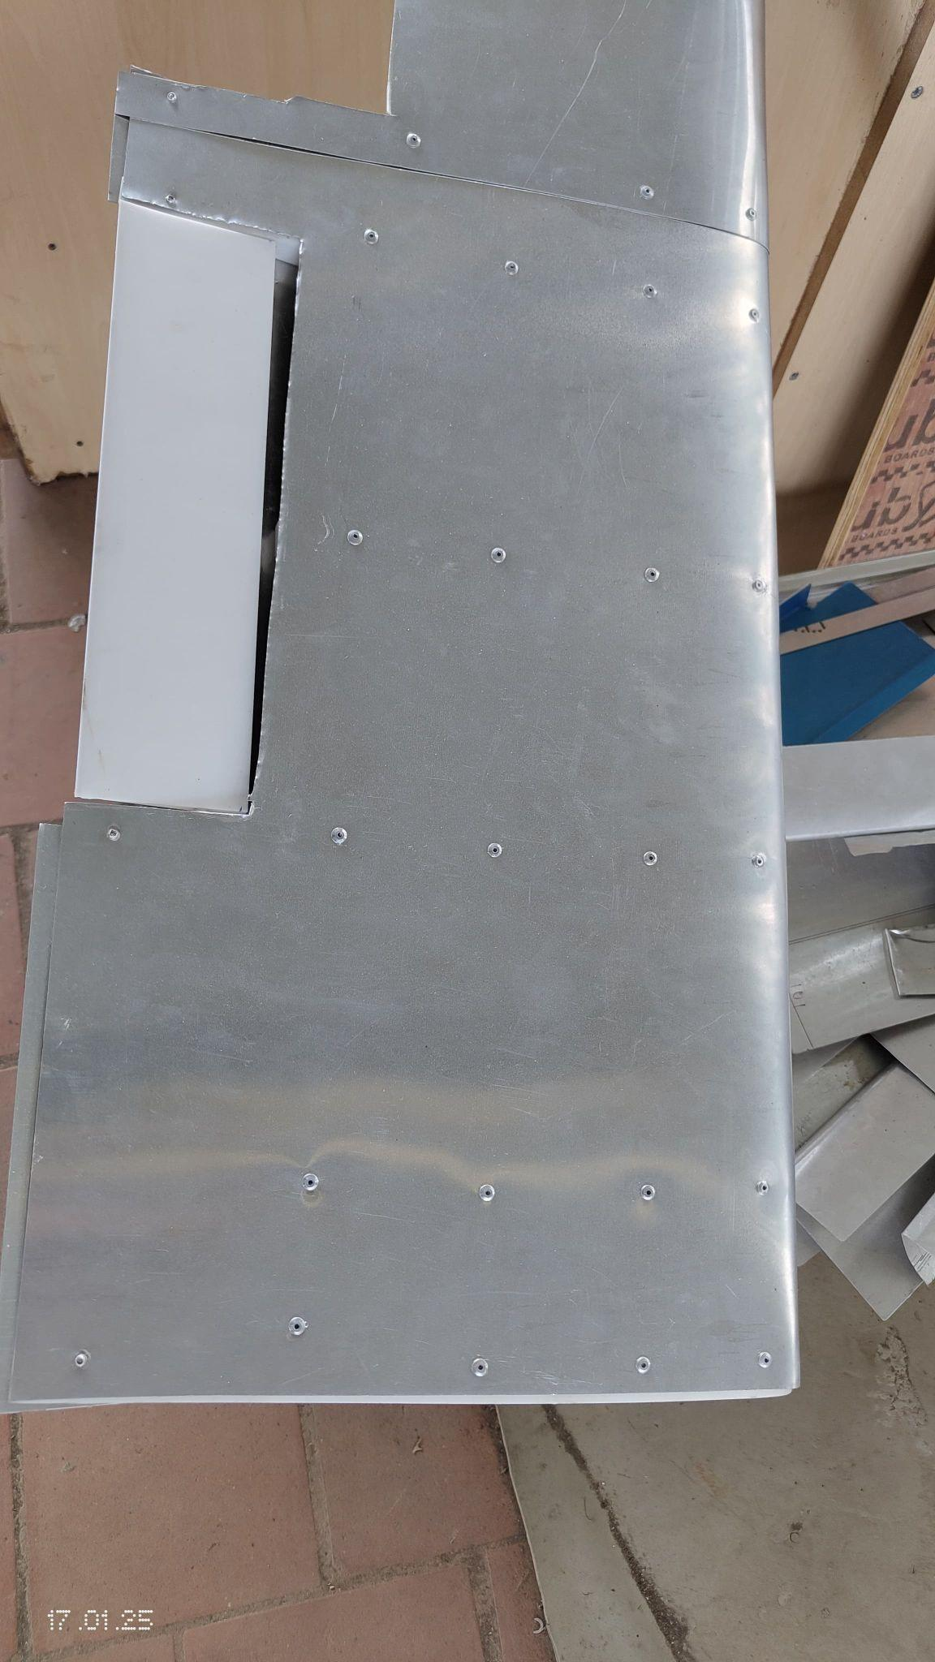
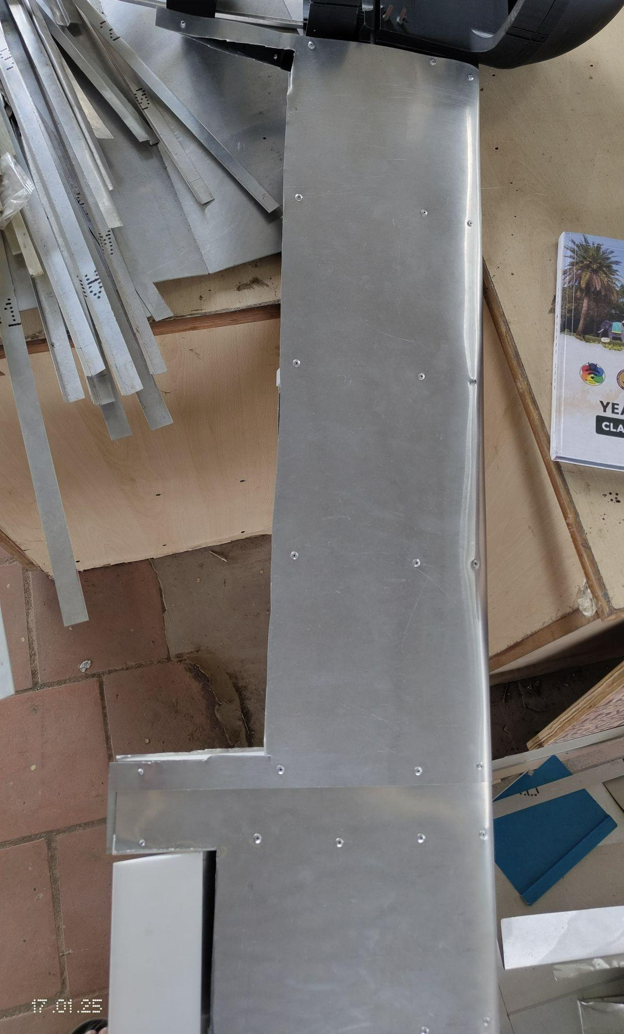
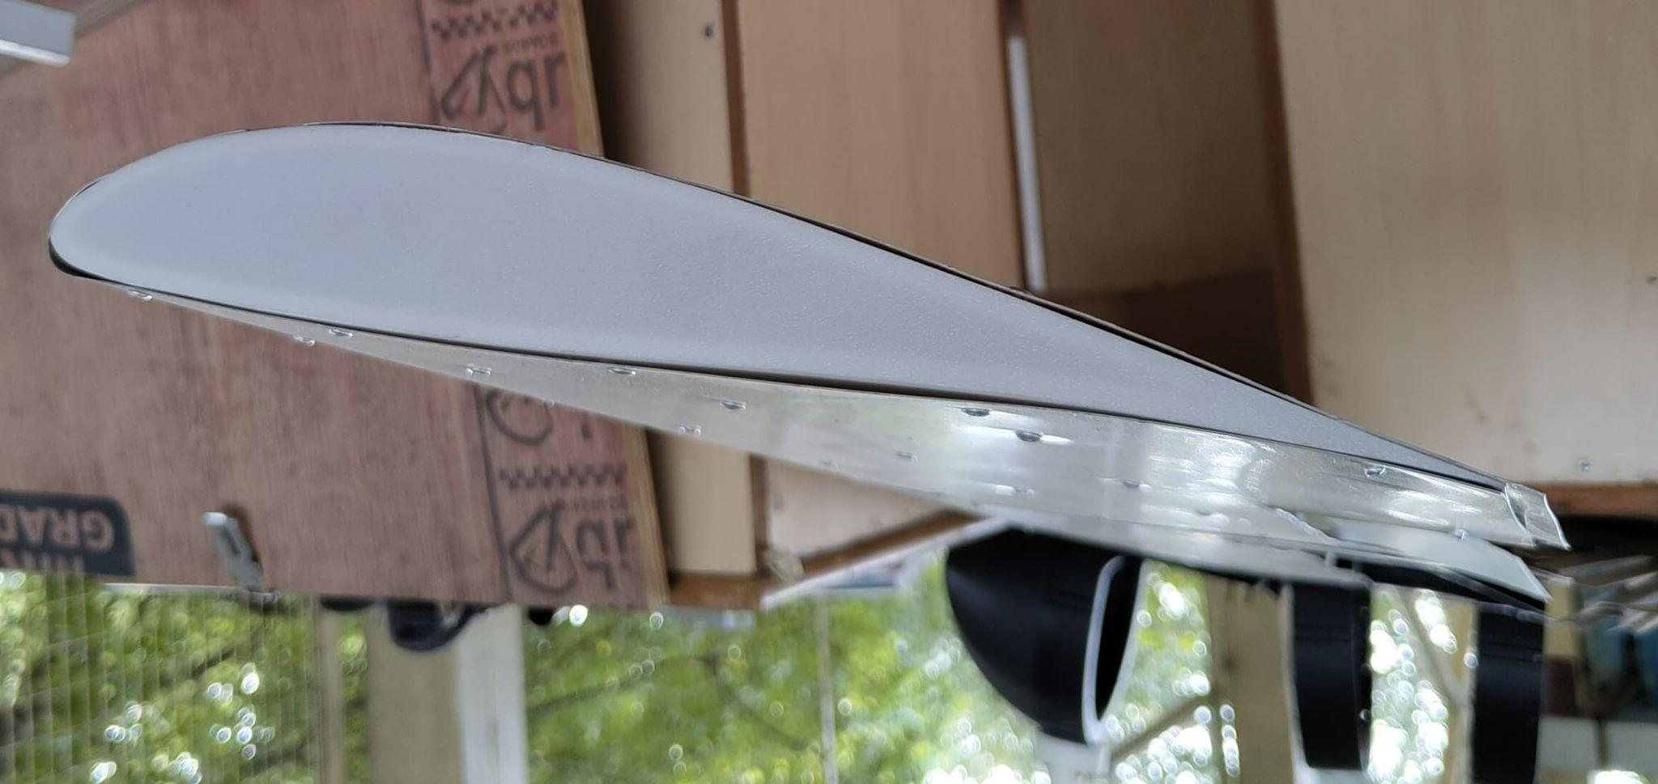
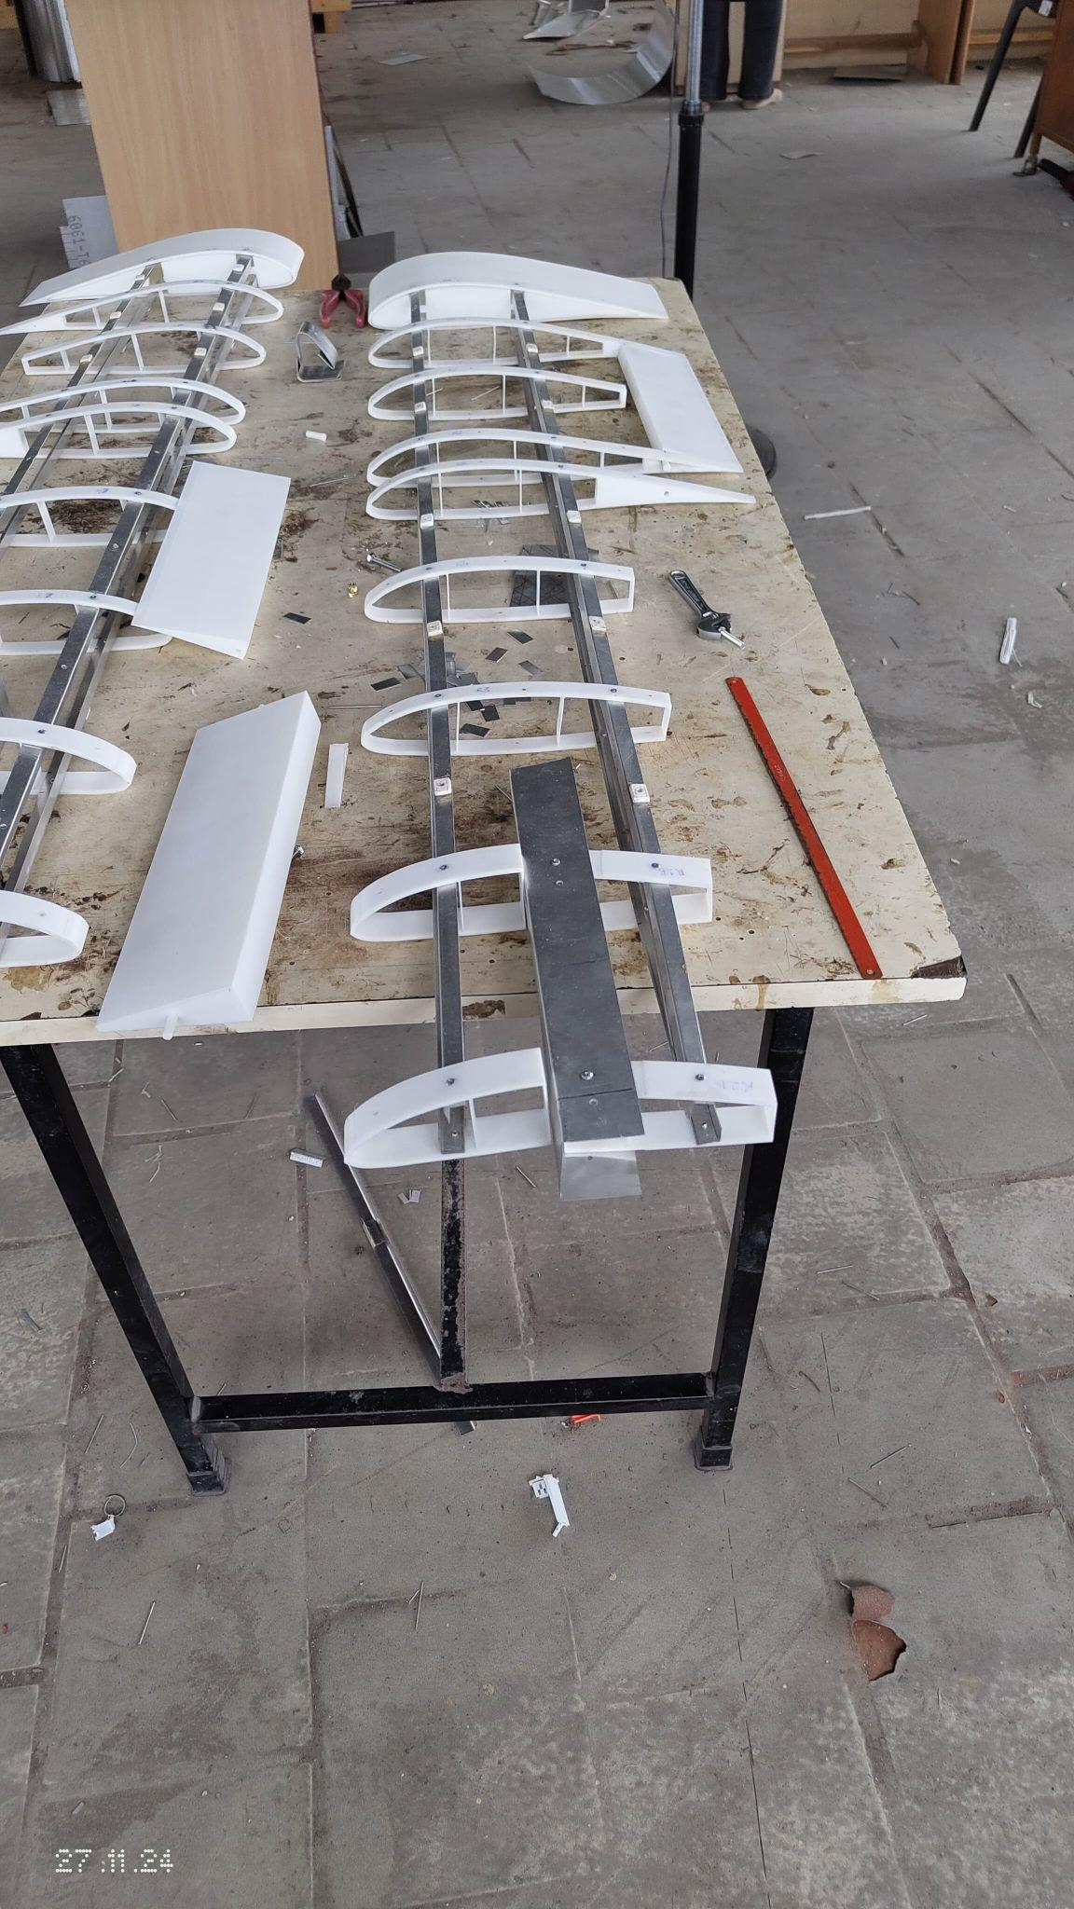
Wing Fabrication
Fabrication started with Wing
Ribs, Ailerons and Flaps were 3D printed
Wing skin was wrapped in 2 sections
0.5 mm Al 6061 thickness skin was used with 4 stringers and 18 ribs
Wing Section 1 with Aileron
Skin wrapped around Rib
Wing Section 2 with Flap Cutout
Wing Internal Structure

Slide 8
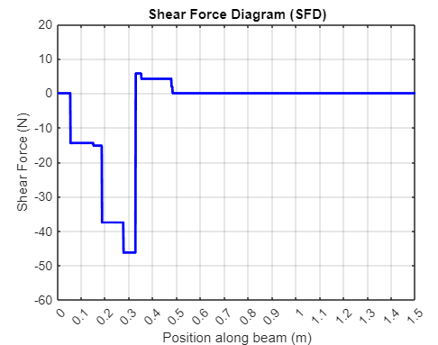
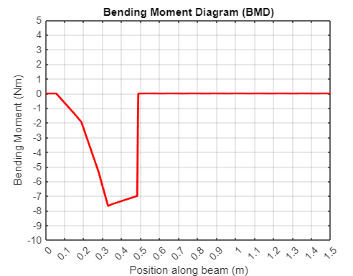
Fuselage SFBM Diagram
Maximum Shear Force = 46 N
Maximum Bending Moment = 7.7 Nm

Slide 9
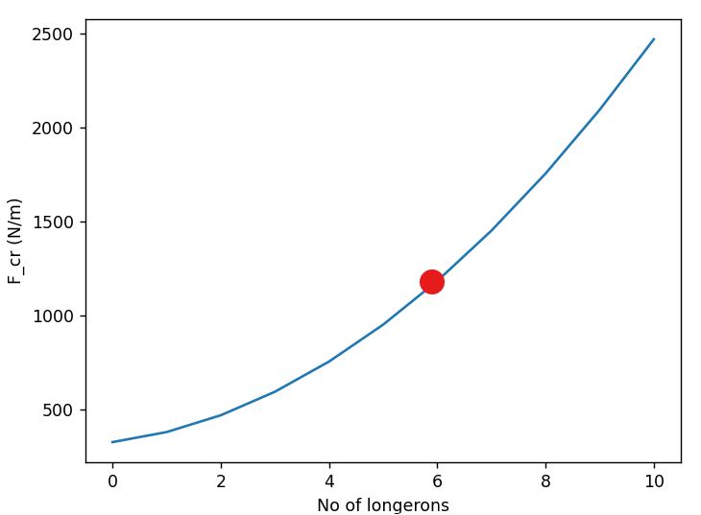
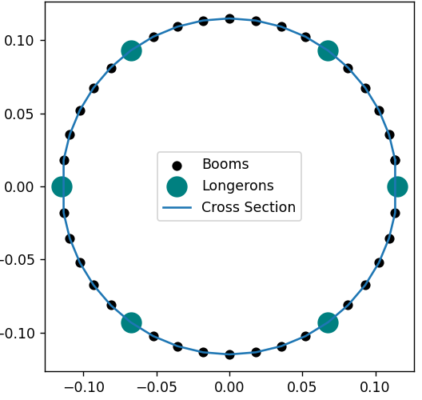
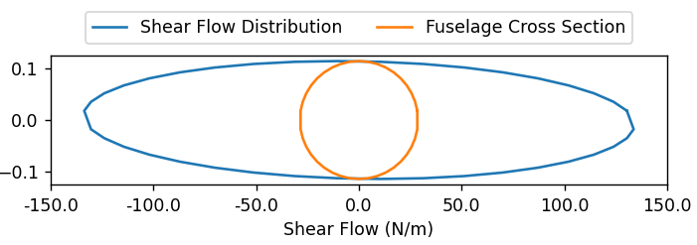
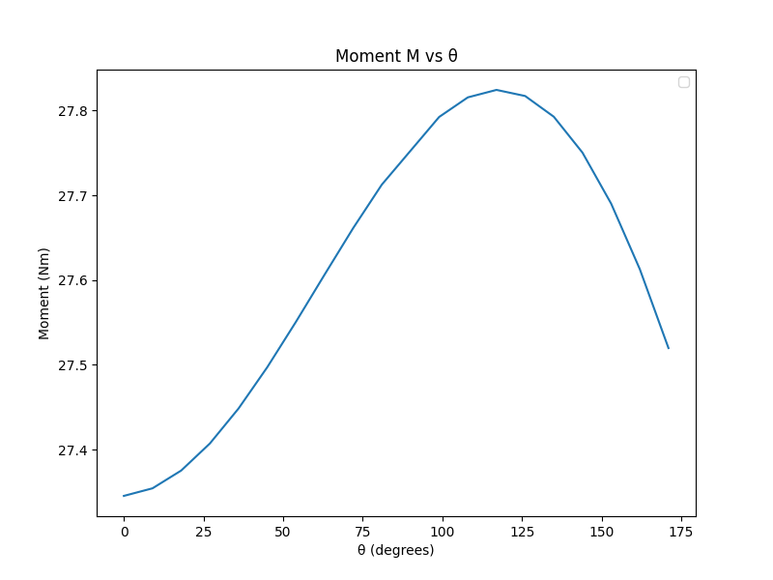
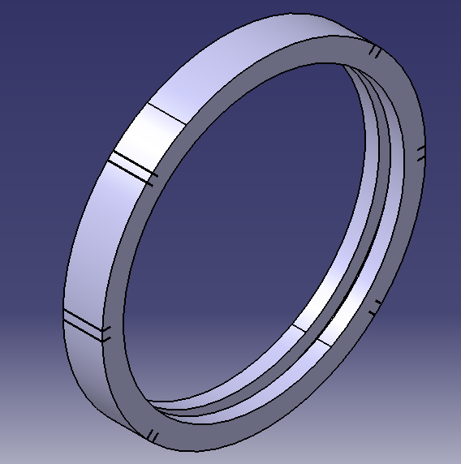
Longeron Selection and Bulkhead Sizing
F_{cr} (N/m)
Set Configuration :
4 Frames, 6 Longerons
No. of Longerons
Max BM = 27 N-m
Radius = 0.115 m
Material: PLA
Cross Section: C Section
Thickness: 10mm
Web: 21 mm
Flange: 15 mm
Moment (N-m)
θ (degrees)

Slide 10
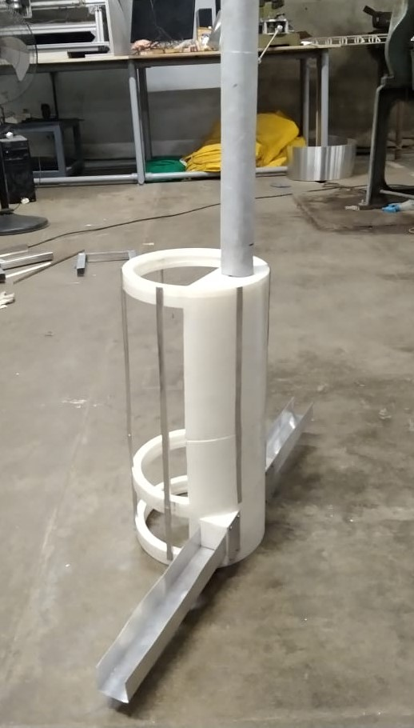
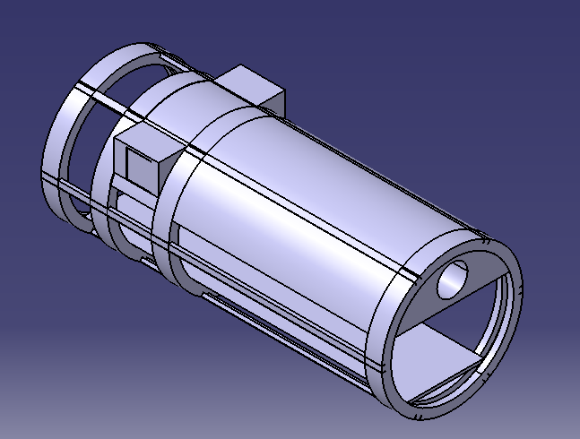
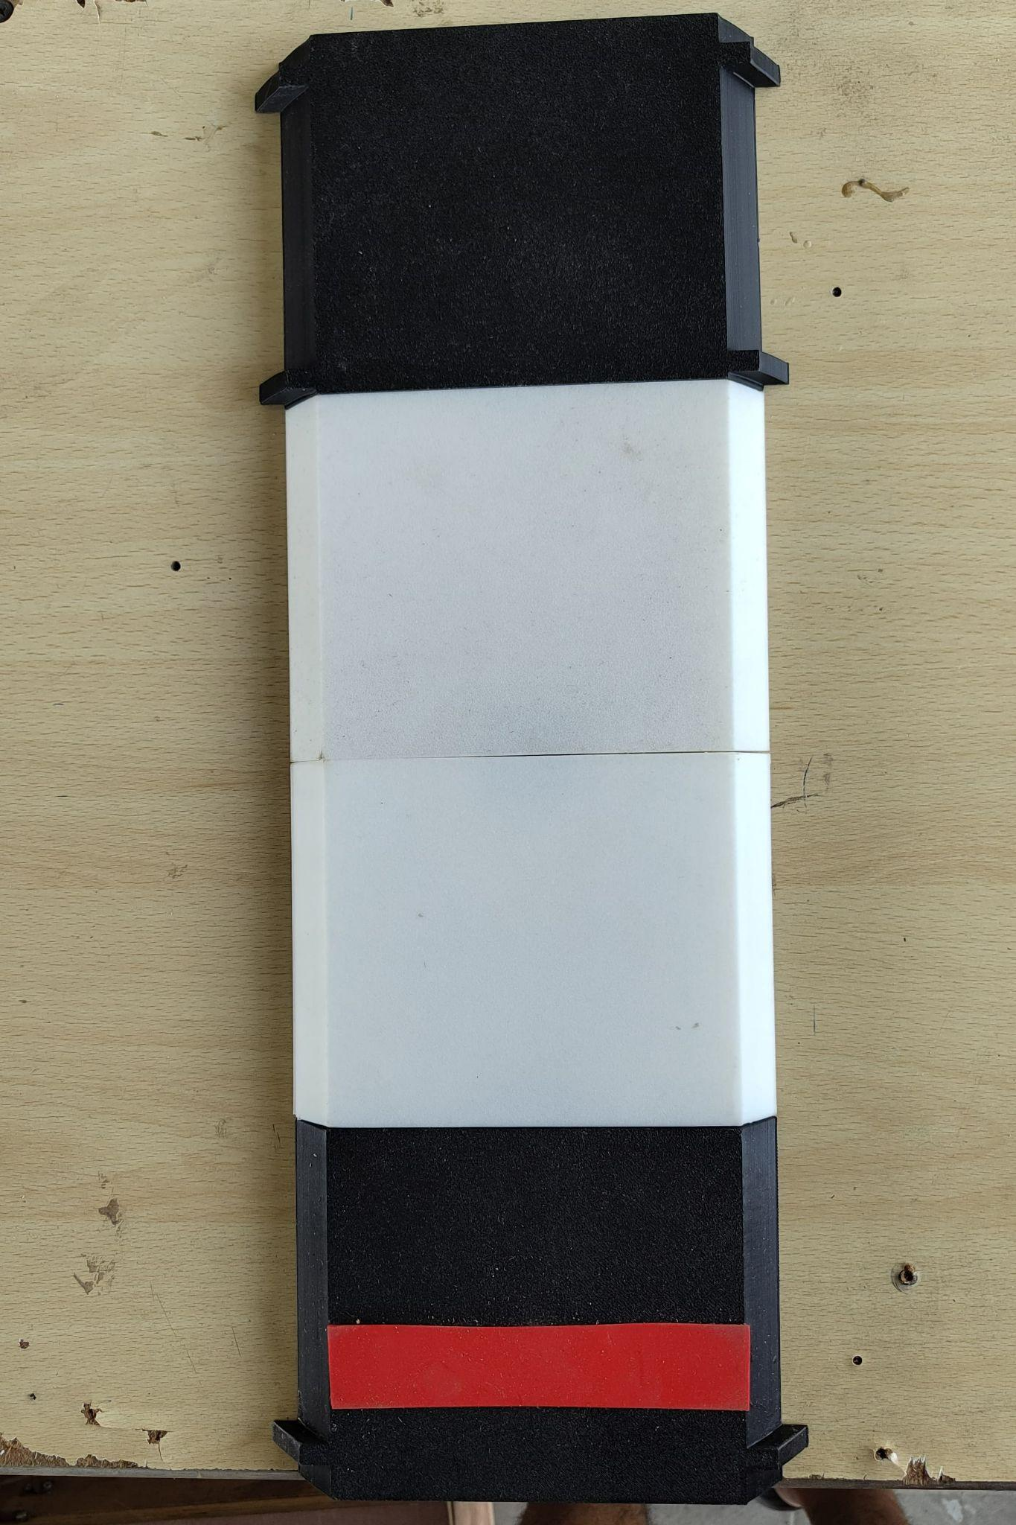
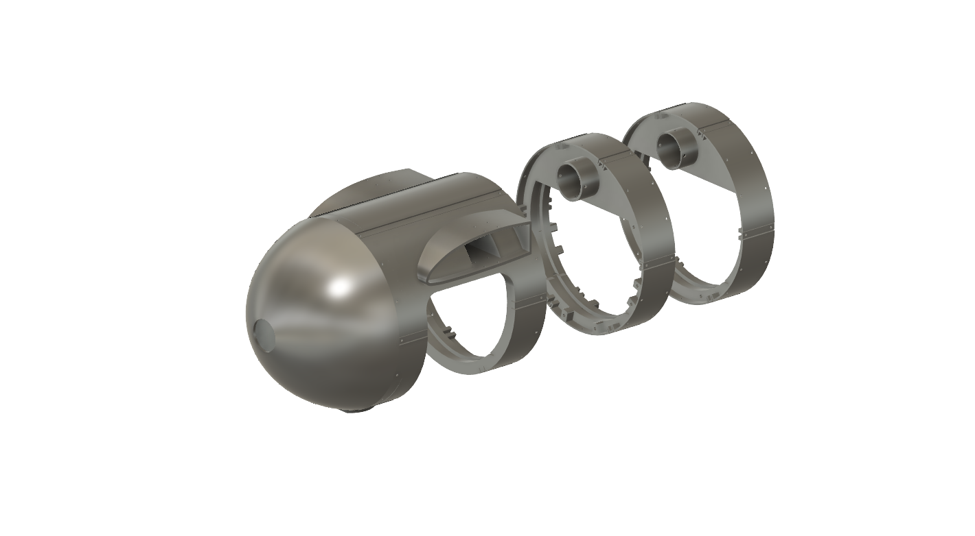
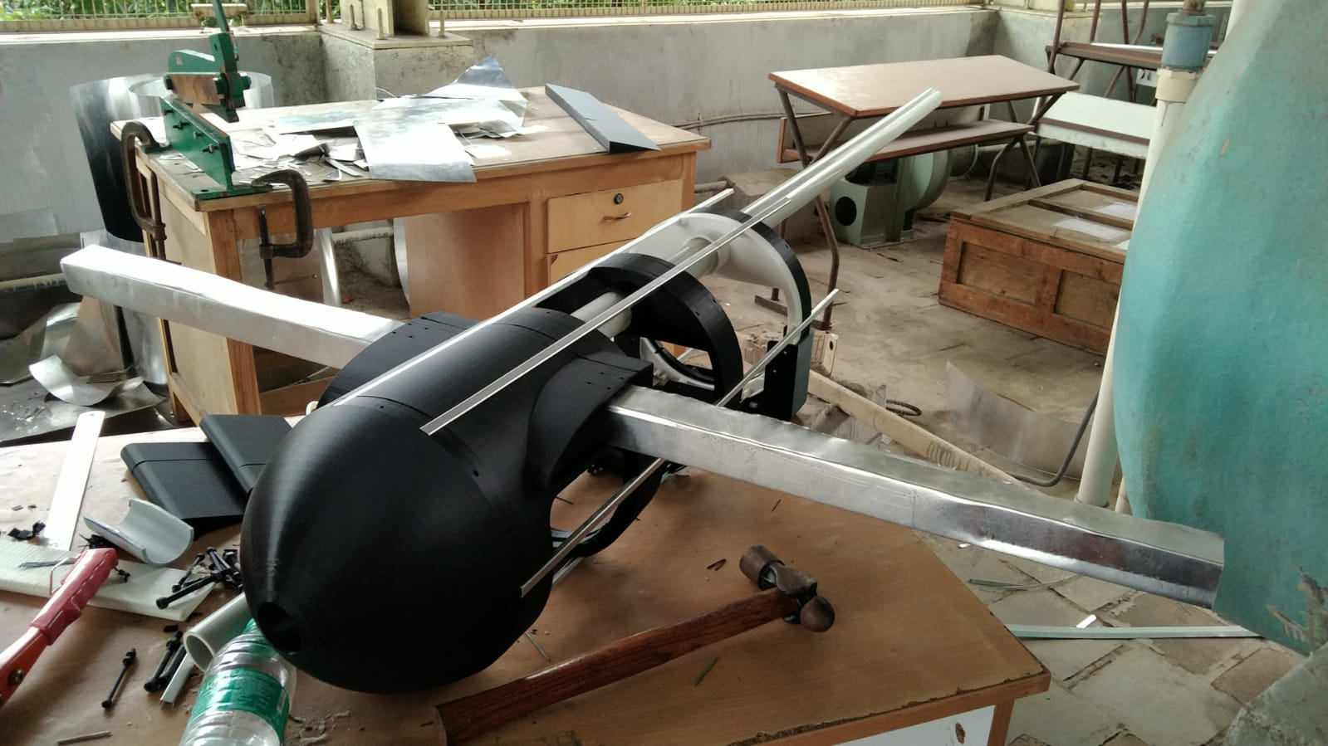
Fuselage Fabrication
Material Used:
Bulkhead: PLA
Longerons: Al 6061
Platform: PLA

Slide 11
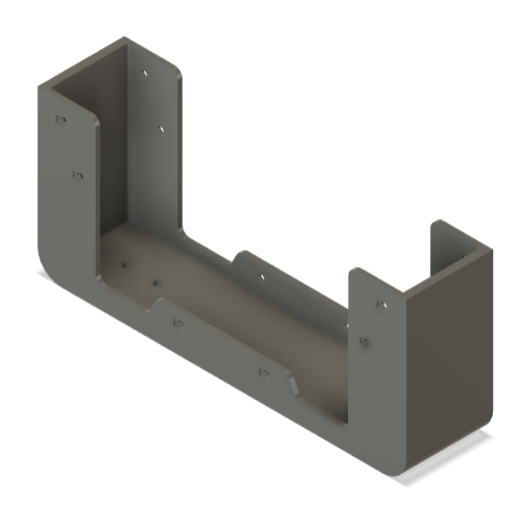
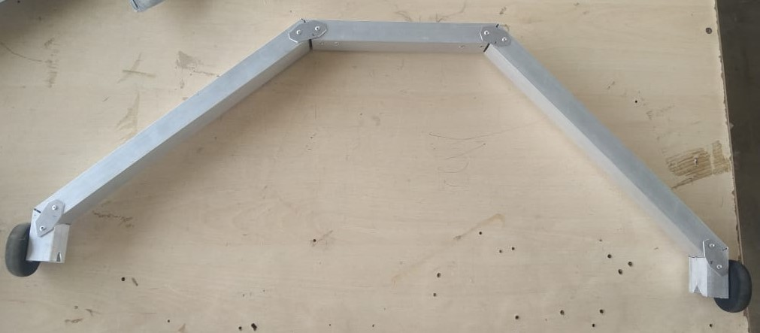
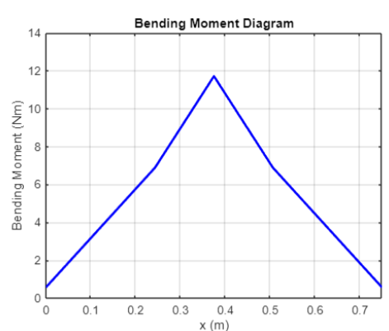
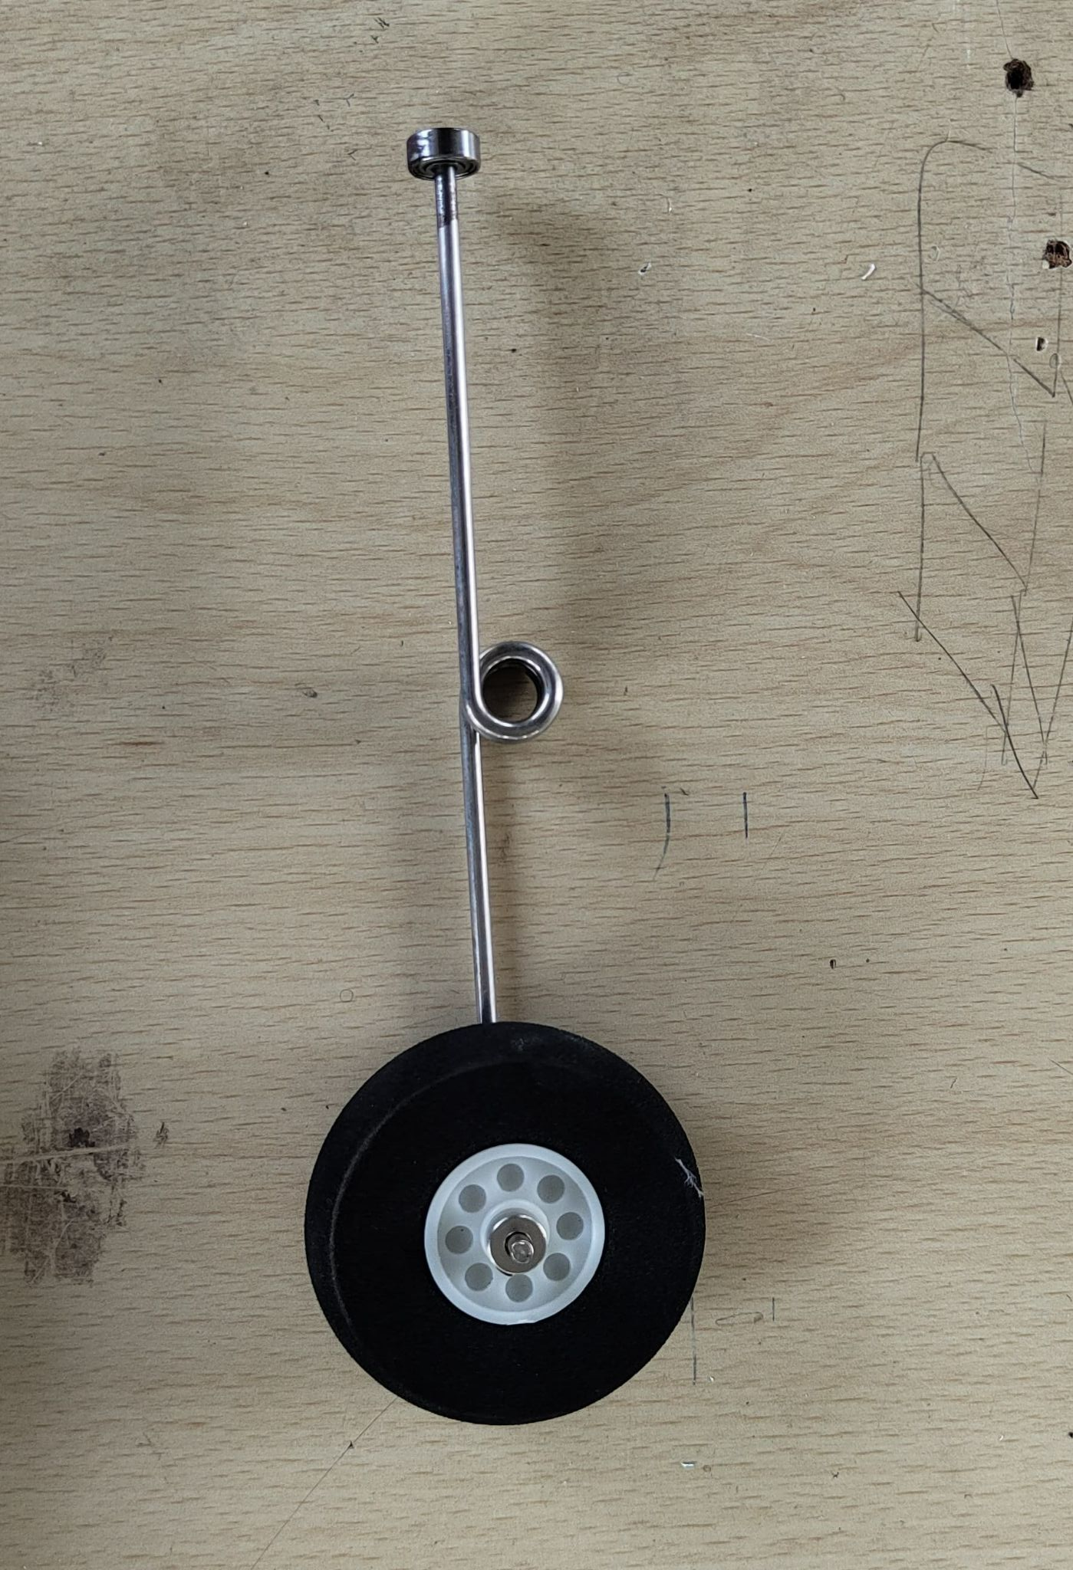
Front Landing Gear
Spring Strut
Landing Gear
Configuration | Tricycle LG
Retractability | Fixed
Position of Nose LG (From Nose) | 0.15m
Position of main LG (From Nose) | 0.35m
Wheel Base | 0.2m
Wheel Track | 0.75m
Wheel Height | 0.29m
Wheel Dia | 89 mm
Wheel Thickness | 31mm
Wheel Material | PU
LG Strut Cross Section | Rectangular
Struct Web | 25 mm
Strut Flange | 20 mm
Landing Gear
Adapter
Landing Gear Assembly
Front Landing Gear
Spring Strut
Max Bending Moment: 11.71N
Max Bending Moment at 0.375m

Slide 12
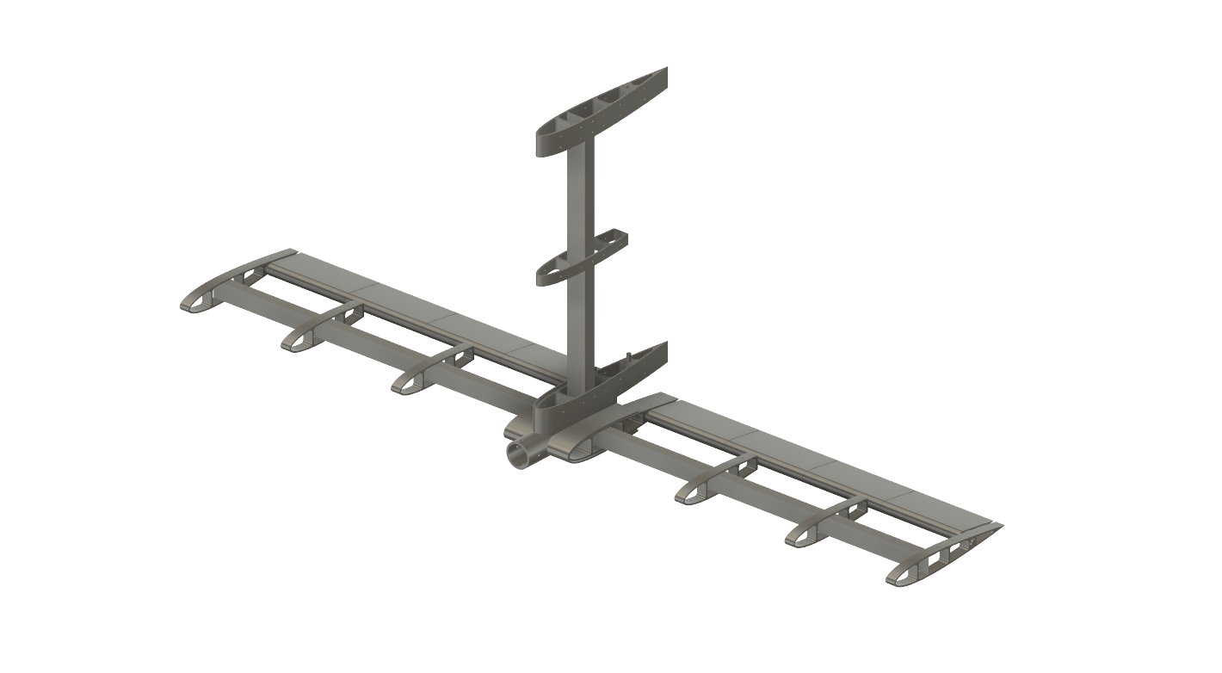
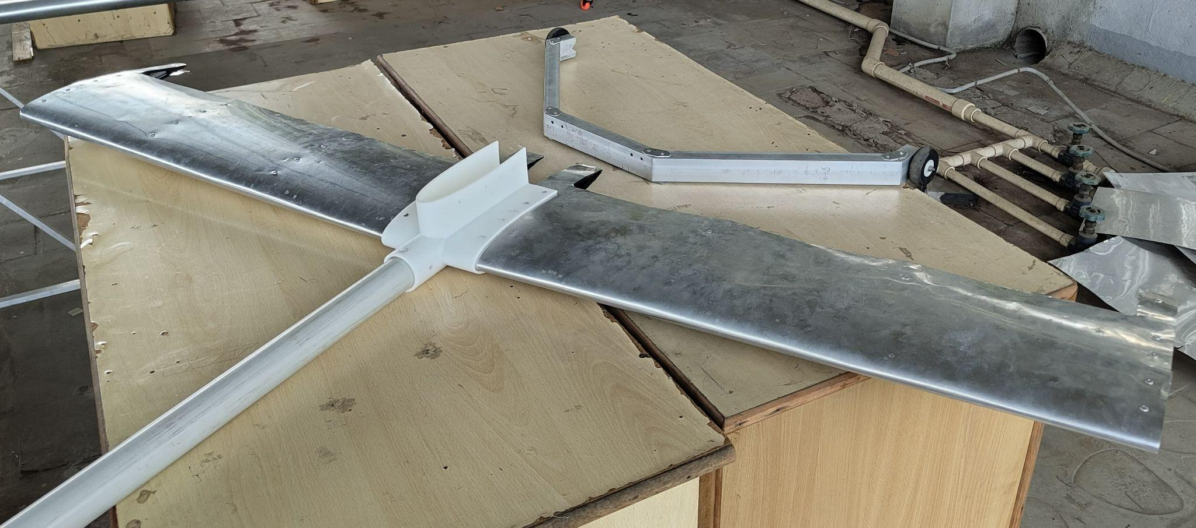
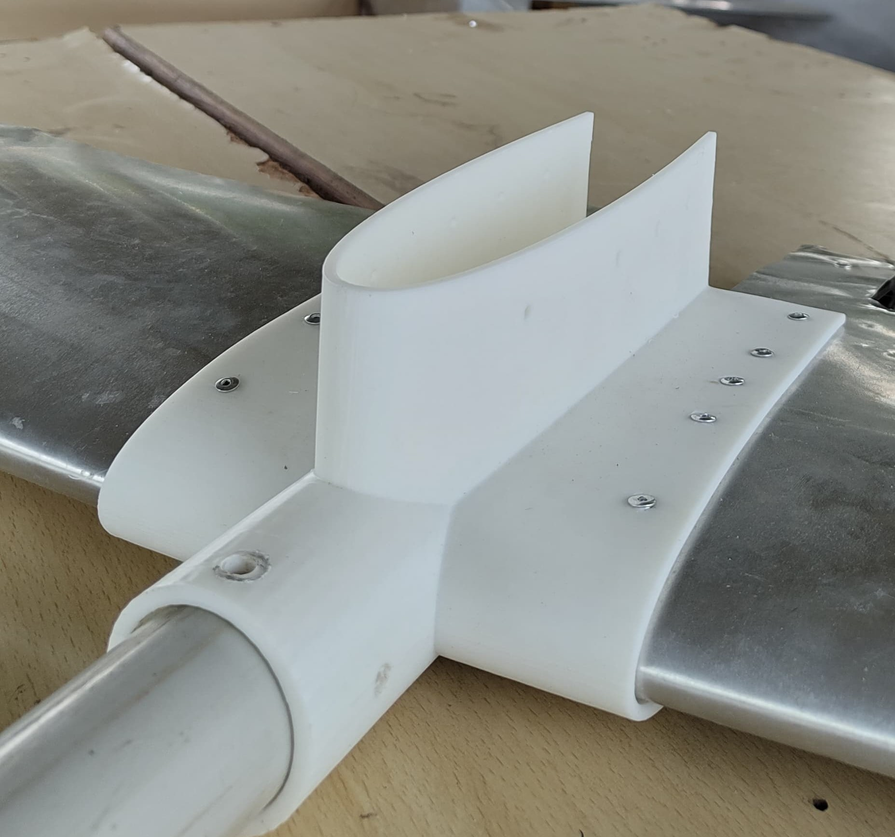
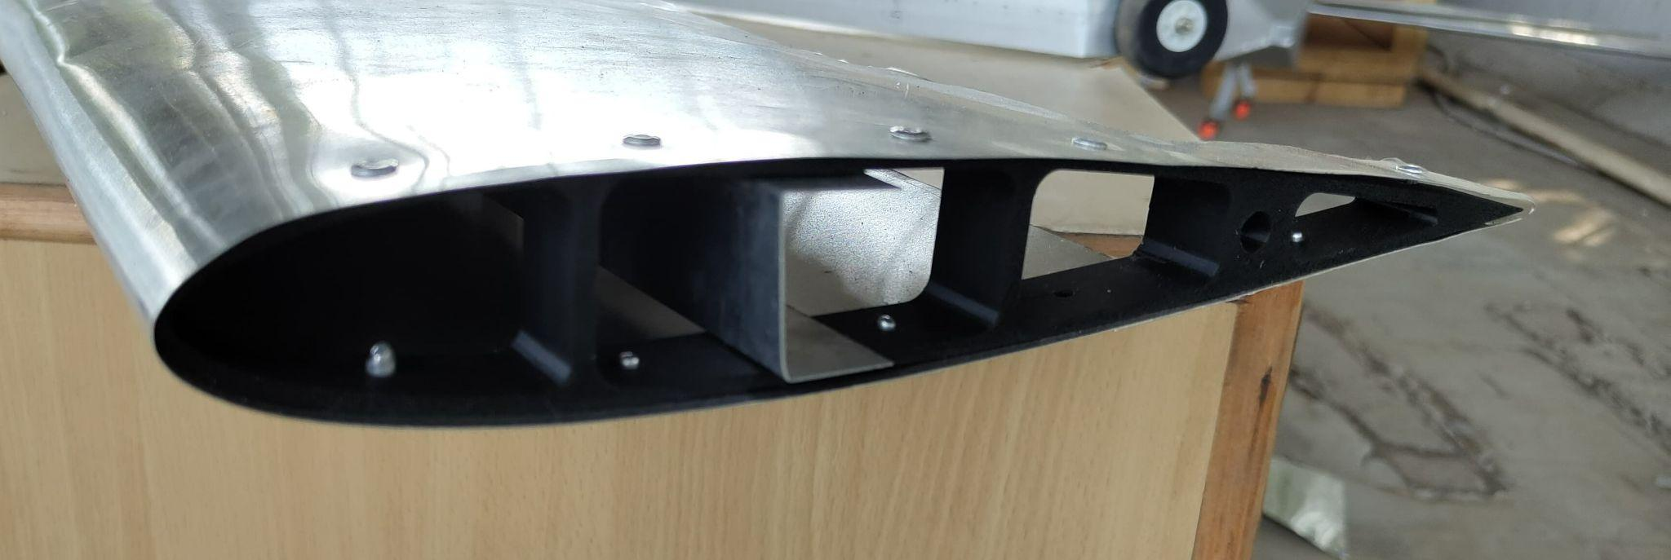
Empennage Fabrication
0.3 mm Skin
Each Horizontal Tail contains 4 NACA 0014 Ribs and 1 Spar of 30 mm web height at max thickness
Ribs and Tail Mount were 3D printed with PLA
2 Tail booms were experimented on :
5cm diameter with 1 cm thickness
4cm diameter with 0.5 cm thickness(displayed)
Vertical Tail couldn't be assembled due to a 3D printer error
Tail CAD Model
Skin wrapped around Tail Rib
Empennage Assembly
Tail Adapter

Slide 13
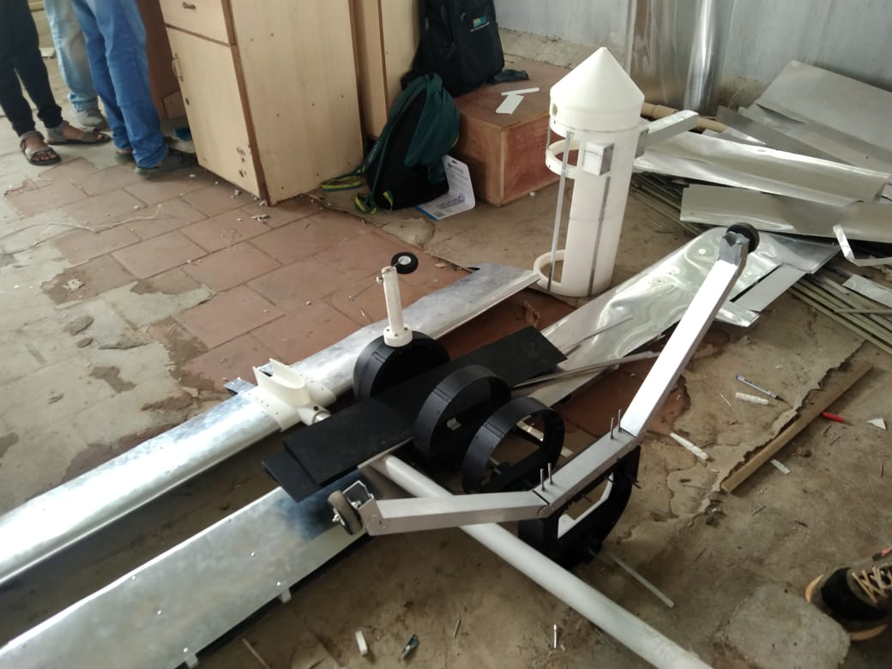
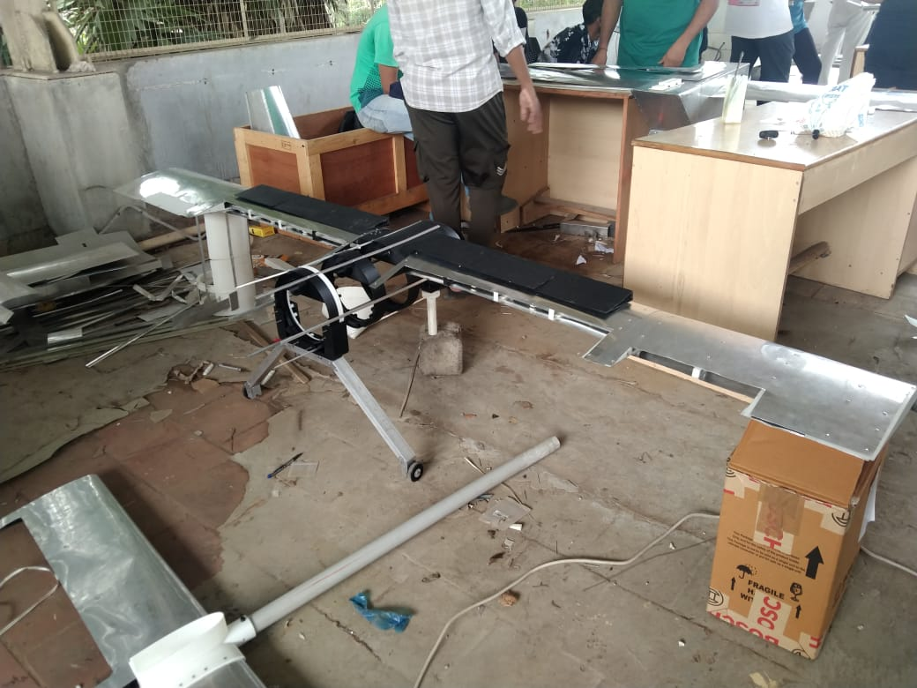
Final Assembly and Challenges Faced
Challenges with Stringer Production: Shear cutting machine couldn't cut 0.5mm sheets, requiring manual cutting, leading to inaccuracies; bending machine only reached 120°, requiring manual bending with wooden mallets, weakening stringers.
Riveting Issues: Faulty rivets caused rework and increased hole diameter, necessitating larger rivets and occasional metal sheets; one rib was damaged beyond repair, delaying wing assembly.
Wing Skin Attachment: Difficulty in shaping 0.5mm aluminum sheets along the airfoil led to errors, especially at the trailing edge, and misalignment of wing-skin sections.
Bulkhead Assembly Challenges: 3D printer limitations caused delays, and a 0.2mm gap at attachment points proved insufficient, requiring manual adjustments with hacksaw blades to meet tolerances and a subsequent 2nd iteration was modelled and printed.
Front Landing Gear Failure: The PLA-made strut, designed for impact absorption with a spring action, failed under fatigue loading; soldering iron molding for roller bearing attachment was unsuccessful.
Broken Nose Landing Gear
Final Assembly

Slide 14
Fabrication Summary
Part | Qty | Material | Fabrication Process
Fuselage
Bulkhead | 4 | PLA | 3D Print
Longeron | 18 | Aluminium | Machining
Wing Attachment | 1 | PLA | 3D Print
Tail Boom Attachment | 1 | PLA | 3D Print
Platform | 1 | PLA | 3D Print
Nose Cone | 1 | PLA | 3D Print
Skin | NA | Aluminium | Machining
Wings
Ribs | 18 (9+9) | PLA | 3D Print
Spar | 01 | Aluminium | Machining
Stringers | 8 (4+4) | Aluminium | Machining
Flaps | 2 (1+1) | PLA | 3D Print
Ailerons | 2 (1+1) | PLA | 3D Print
Skin | 1 | Aluminium | Machining

Slide 15
Fabrication Summary
Part | Qty | Material | Fabrication Process
Empennage
Tail Boom | 1 | Aluminium | Machining
Tail Boom Adapter | 1 | PLA | 3D Print
Horizontal Tail | 2 | PLA | 3D Print
Elevator | 2 | PLA | 3D Print
Vertical Tail | 1 | PLA | 3D Print
Rudder | 1 | PLA | 3D Print
Landing Gear
Struts | 1 | Aluminium | Machining
Wheels | 1 | PU | NA

Slide 16
Contributions
ANISH : Report : Lift Distribution, Wing SFBM, Spar Design, Wing Idealization and Shear Flow Calculation, Shear Flow Calculations with Stringers and Spar, Fuselage Cross Section Shear Flow Calculations, Longeron Selection, Bulkhead Sizing (Validation), Fabrication Chapter
Fabrication : Riveting Rib and Stringer, Attaching Wing Skin, Helped in assembling 1st fuselage, 2nd fuselage iteration CAD Modelling and 3D Printing, manufacturing longerons and spar, assembling 2nd fuselage, brought 2nd tail boom, CAD Modelling Empennage and 3D Printing Tail Ribs and Tail Adapter, Manufacturing Tail Spar, Assembling both Horizontal Tails, CAD Modelling Landing Gear Adapter and 3D Printing, attaching Main LG to Adapter and Bulkhead
Vinu:
Report : Bill Of Materials, Assisted in Spar design, Torque estimation of servo selection, Fuselage SFD, BMD, Bulkhead sizing, Landing Gear Design, Fabrication Chapter
Fabrication : Fabrication of stringers and longerons, assisted in design of wing ribs, wing rib and striger attachment, Design of 1st iteration of bulkhead and fuselage skeleton, assembly of fuselage, fabrication of Spar, Wing skeleton layout, Aileron and flap attachment to wing, assembly of wing skin, assembly of tail skin, attachment of tail booms to fuselage, fabrication of Landing gear strut. redesign of main landing gear strut, assembly of landing gear to fuselage, design and assembly of nose landing gear, design and assembly of nose cone.
Abhigyan: Report: Problem Definition, Wing SFD BMD writing, Spar Design writing, Fuselage design writing, Bulkhead design and calculations; Fabrication: Different Wing Ribs and Ailerons CAD Modelling and 3D printing, Helped in Wing and Horizontal Tail assembly and Skin riveting, assembly of Landing Gear adapter with Main LG, involved in most of the 3D printed parts and helped in overall assembly of both iterations
Gautham:
Report : Assisted in Torque estimation of servo selection, Fuselage SFD, BMD, Landing Gear Design.
Fabrication : Fabrication of stringers and longerons, wing rib and striger attachment, assembly of fuselage, fabrication of Spar, Aileron and flap attachment to wing, assembly of wing skin, assembly of tail skin, attachment of tail booms to fuselage.fabrication of Landing gear strut. redesign of main landing gear strut, assembly of landing gear to fuselage, design and assembly of nose landing gear, design and assembly of nose cone.
Aditya
Report : Assisted in Bill Of Materials, Assisted in torque estimation of servo selection, Assisted in Fuselage SFD and BMD.
Fabrication : Fabrication of stringers and longerons, wing rib and striger attachment, assembly of fuselage, fabrication of Spar.

Slide 17
Thank You

